Slide 1
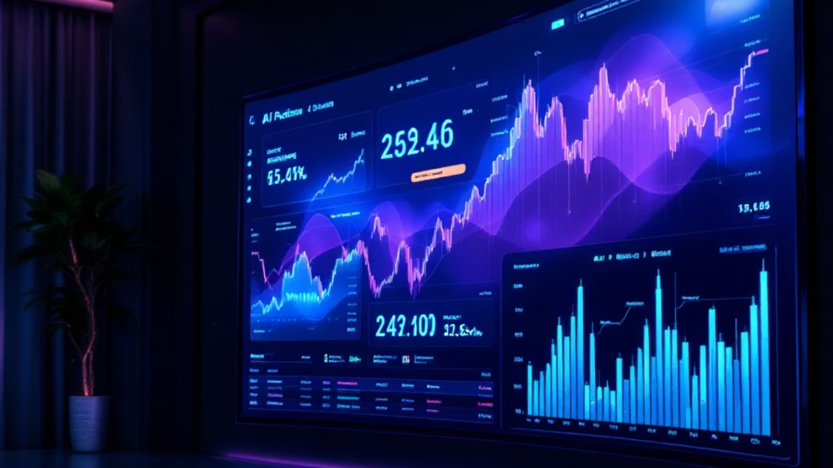

AI-Powered Financial Analysis & Stock Prediction System
A revolutionary approach to financial data analysis using artificial intelligence. This system automates interpretation of financial statements, assesses firm performance, and predicts stock trends using machine learning and natural language processing.
by Pavan Kumar Pabba

Slide 2




Introduction & Motivation
Economic Volatility
Manual Analysis Inadequate
Financial industry faces accelerating information flow and unpredictable market dynamics.
Traditional methods are time-consuming, lack scalability, and cannot incorporate real-time data.
Need for Predictive Insight
Investors require systems that provide real-time recommendations and adaptive insights.

Slide 3
Background & Resources
AI in Finance
Key Resources
AI has emerged as a transformative force in financial modeling, portfolio management, and market prediction.
Academic research on Design Science
Machine learning frameworks
Machine learning for stock forecasting has evolved from basic models to complex architectures like RNNs and LSTMs.
Financial data sources (Yahoo Finance, SEC EDGAR)
Open-source tools (Python, TensorFlow, NLTK)

Slide 4








Need for AI in Stock Prediction
Predictive Power
Data Overload
AI models capture non-linear market dynamics beyond traditional statistical methods.
AI processes massive structured and unstructured financial data at scale.
Sentiment Analysis
Real-Time Support
AI quantifies emotional tone from news and social media as market indicators.
AI enables immediate processing of streaming data for timely decisions.

Slide 5






Diagnosis Cycle - Problem Space Model
Goodness Criteria
Predictive accuracy, transparency, timeliness, user experience, scalability
Stakeholder Analysis
Retail investors, institutional analysts, portfolio managers, FinTech developers
Problem Identification
Data complexity, interpretation gaps, market volatility, analysis delays

Slide 6
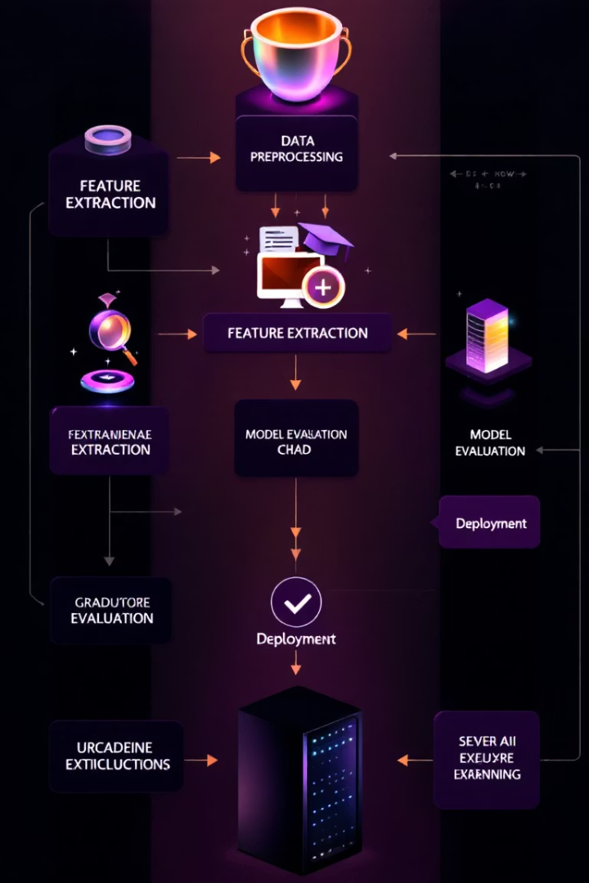




Design Cycles - Machine AI Design
Data Sources & Features
Financial reports, historical stock data, news sentiment, computed ratios
Machine Learning Models
XGBoost for classification, LSTM for forecasting, BERT/VADER for sentiment
Financial Health Classification
Models assess company stability using ROE, EPS, debt ratios
Explainability & Interpretability
SHAP and LIME models ensure predictions remain auditable and transparent

Slide 7
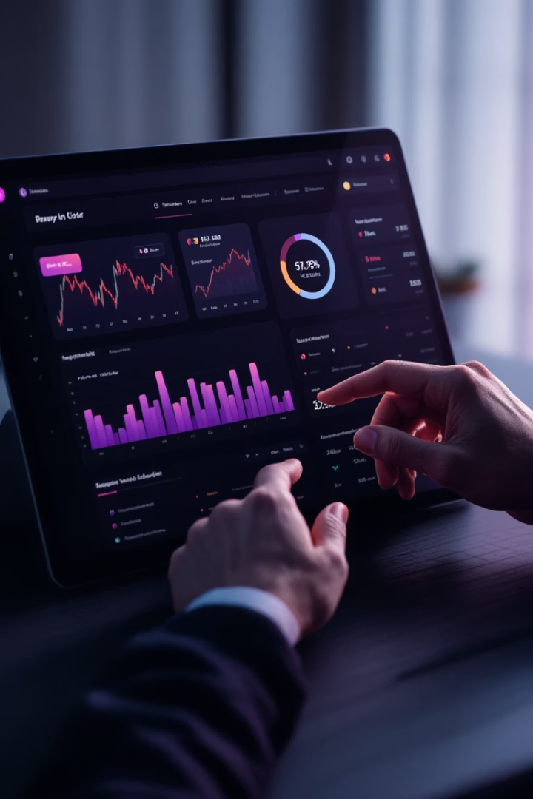
Human Behavior Design
User Interface Design
Key Features
Interactive dashboards built with Dash or Streamlit for real-time analysis. Color-coded risk gauges and trend charts enhance visual clarity.
Customizable watchlists, threshold alerts, and one-click report generation. Users can toggle between sentiment, price prediction, and financial insights.
Cognitive Load Considerations
Minimalist design reduces decision fatigue. Tooltips and visual aids explain predictive outcomes in layman's terms.

Slide 8



Implementation Cycle
Architecture & Technology Stack
Modular design with Python frameworks and ML libraries
Use Case Implementation
Comprehensive workflow from data upload to insight generation
Demonstration & Validation
Live prediction panels, visualization tools, and technical testing

Slide 9





Project Implications
Technological
Advances explainable AI in FinTech, automates financial modeling, and demonstrates scalable architecture.
Business
Democratizes investment analytics, enhances decision speed, and integrates with existing platforms.
Behavioral
Shifts toward proactive decision-making, builds trust through transparency, and educates users.
Ethical & Societal
Promotes responsible AI use, ensures data privacy, and fosters human-AI collaboration.

Slide 10

Conclusions & Future Directions
1
2
3
DSR Success
AI Integration
Future Growth
Project demonstrates value of Design Science Research methodology
System successfully combines machine intelligence with human-centered design
Potential for real-time data streaming, portfolio-level prediction, and global expansion

